Slide 1
Case Study – Telemetry
Team 7

Slide 2
Team Members
Pavan Kumar Jonnadula
Vamsi Alapaty
Harish Jaladi
Shajahan Mohammad
Ramya Deshetti
Naveen Krishnam
Sarath Boddu
Raju Thada

Slide 3
Introduction
In this modern world, technology is playing major role. We can see that AI is all over the world and it is being utilized in all fields like manufacturing, medical and IT etc. AI has reduced the efforts of many people to complete the tasks. Few example where AI is being used are self driving cars, developing applications and writing up new Gmail with the user input. So, to grow along with the world we need to develop our applications and analyze them how it works. As a part of it we decide to operate the car using mobile phone. So, we have the idea of operating the car through mobile but what is the best view to control the car and how it is efficient for the user to drive the vehicle is something more important.
So, This is the Case Study to analyze and determine which approach is better to drive the vehicle. For this we have used 2 Cars with High-Speed motor and Camera attached connected to the mobile phone. For this we have created a track with Length of 42 feet and width of 1.5 feet.

Slide 4
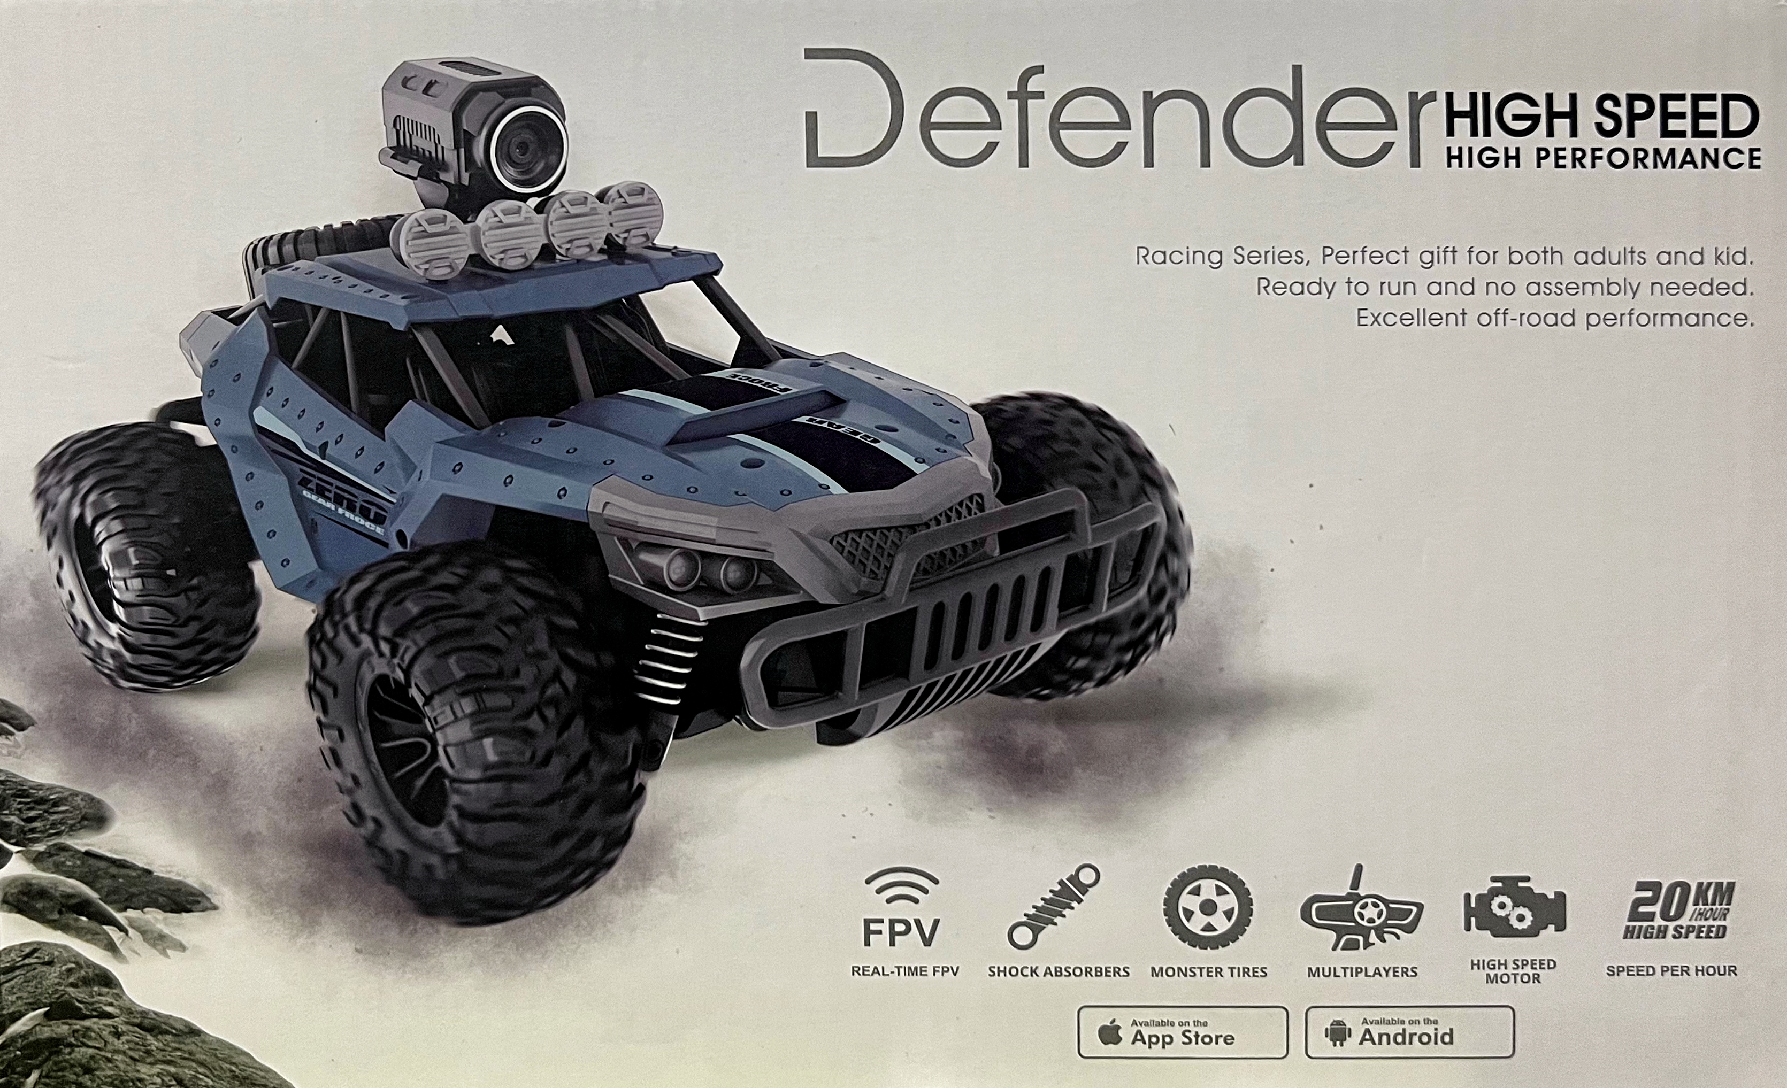
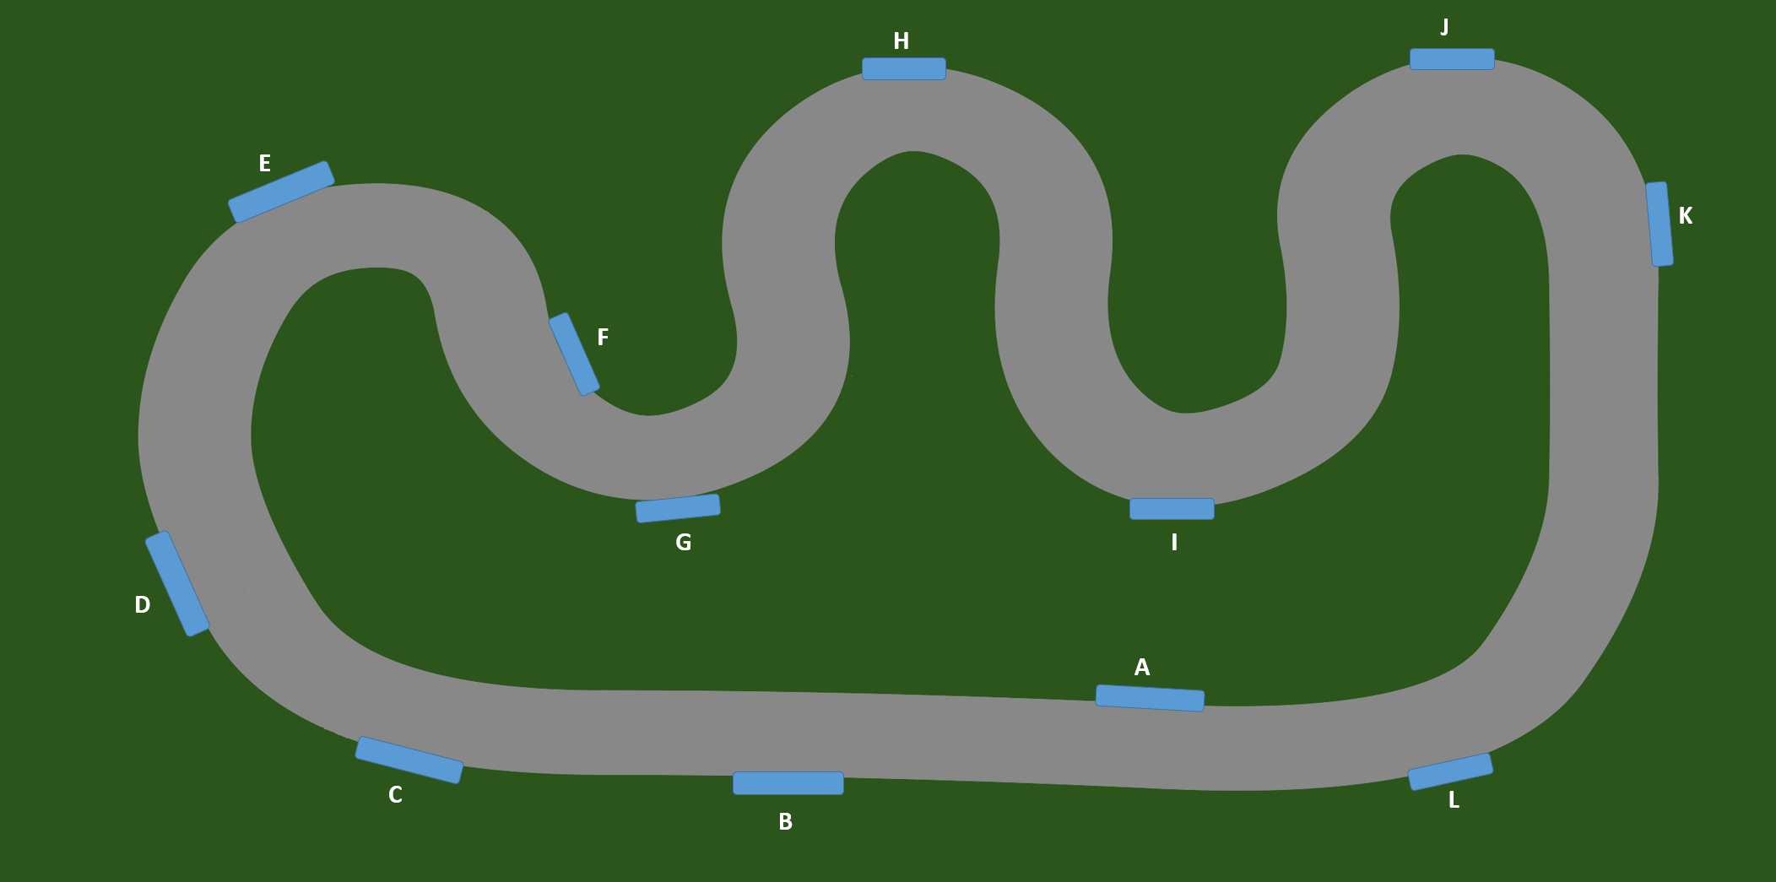
Equipment
Car Driven
Race Track
Track details:
Length: 42 feet
Loops: 5
Width: 1.5 feet
Obstacles: 12
Car details:
Name: Defender High Speed
Top speed: 20kmph / 12.5 mph
Length: 1 feet
Width: 0.8 feet
Control: Remote and Mobile operation

Slide 5
Motivation
In recent years, the automotive industry has witnessed a surge in the popularity of automated cars. There is a growing interest among individuals to incorporate electrified and automated vehicles into their daily routines. One of the primary motivations behind this trend is the potential reduction in the manual effort required to operate a vehicle. Consequently, this reduction in manual control holds the promise of minimizing accidents caused by human errors. To substantiate these claims, a comprehensive case study was conducted to assess the reliability of remote vehicle operation.

Slide 6
Objective
Our objective is to analyze the performance of the car control using both the views. One view is to control the car using the camera that is attached to the car. Here this is considered as Car view and the other view is Rear view where the user will see the car completely and then they will control the vehicle. This is named as Driver view obstacles. Using these two views we have controlled the car on the track that is created with 12 obstacles. As a team we have 8 car views and 8 drive views and the count of the car hits with the obstacles is need to be calculated. Based on the end results we can finalize which view is better to handle the car remote.

Slide 7
Implementation
A team of eight members was assembled to validate the driving accuracy in both modes. The accuracy assessment involved calculating the number of obstacles hit during vehicle operation. In the first mode, where the vehicle is driven using the remote control with a 2.4GHz frequency signal, users benefited from a third-person view of the vehicle. This perspective enabled them to easily avoid obstacles, resulting in higher driving accuracy. In the second mode, the vehicle was operated using the "Heliway Racing" mobile application. Users drove the vehicle by relying on the high-definition video transmitted from the camera mounted on top of the vehicle. Prior to the driving phase, users were familiarized with the track to minimize errors. It should be noted that most users were not accustomed to driving remote-controlled vehicles. The participants then proceeded to drive the vehicle in both modes, and relevant metrics were recorded for analysis and evaluation.

Slide 8
Results
After calculating and analyzing the data from the videos and the obstacles we can confirm that the Car View controlling is quite effective when compared to Driver view.
Users | Third Person View | First Person View
Pavan Kumar Jonnadula | 1 | 5
Vamsi Alapaty | 3 | 5
Naveen Krishnam | 6 | 14
Harish Jaladi | 3 | 5
Raju Thada | 4 | 7
Sarath Boddu | 2 | 9
Mohammed Shahajan | 5 | 7
Ramya Deshetti | 6 | 11

Slide 9
Thank You

